Slide 1


Diabetes Prediction
A.Akash(RA1911003010479)
T.Rithvik(RA1911003010499)
D.Aditya(RA1911003010503)

Slide 2

Problem Definition
Machine Learning is used across many spheres around the world. The healthcare industry is no exception. With the rapid development of machine learning, it has been applied to many aspects of medical health.
Such information, if predicted well in advance, can provide important insights to doctors who can then adapt their diagnosis and treatment per patient basis. With the development of living standards, diabetes is increasingly common in people’s daily life. Therefore, how to quickly and accurately diagnose and analyze diabetes is a topic worthy studying.

Slide 3

Diabetes Data Dictionary
The target variable is specified as "outcome";
1 diabetes test result being positive, 0 indicates negative.
Pregnancies: Number of times pregnant
Glucose: Plasma glucose concentration a 2 hours in an oral glucose tolerance test
Blood Pressure: Diastolic blood pressure (mm Hg)
Skin Thickness: Triceps skin fold thickness (mm)
Insulin: 2-Hour serum insulin (mu U/ml)
BMI: Body mass index (weight in kg/(height in m)^2)
Diabetes Pedigree Function: Diabetes pedigree function
Age: Age (years)
Outcome: Class variable ( 0 - 1)

Slide 4

Libraries used
Numpy- NumPy is a library for the Python programming language, adding support for large, multi-dimensional arrays and matrices, along with a large collection of high-level mathematical functions to operate on these arrays.
matplotlib-Matplotlib is a plotting library for the Python programming language and its numerical mathematics extension NumPy.
sklearn-Scikit-learn (Sklearn) is the most useful and robust library for machine learning in Python. It provides a selection of efficient tools for machine learning and statistical modeling including classification, regression, clustering and dimensionality reduction via a consistent interface in Python
pandas-Fast, powerful, flexible and easy to use open source data analysis and manipulation tool, built on top of the Python programming language.

Slide 5
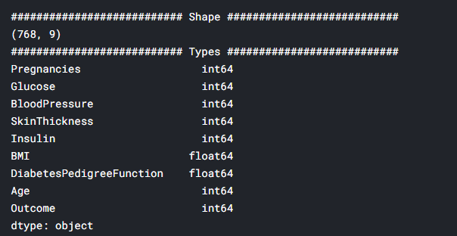
Data Exploration
Data set from Kaggle has been used. The dataset is available at the National Institutes of Diabetes-Digestive-Kidney Diseases in the USA. It is part of the large data set.It consists of 768 observations and 8 numerical independent variables.

Slide 6
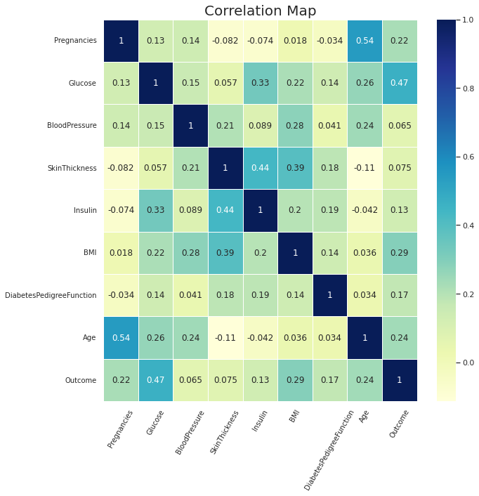
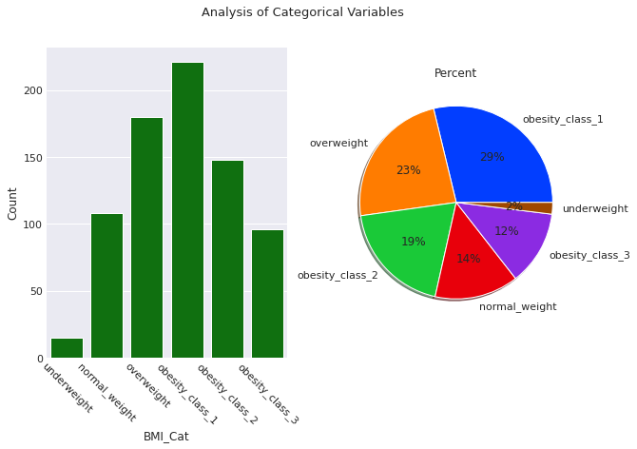
Data visualization

Slide 7
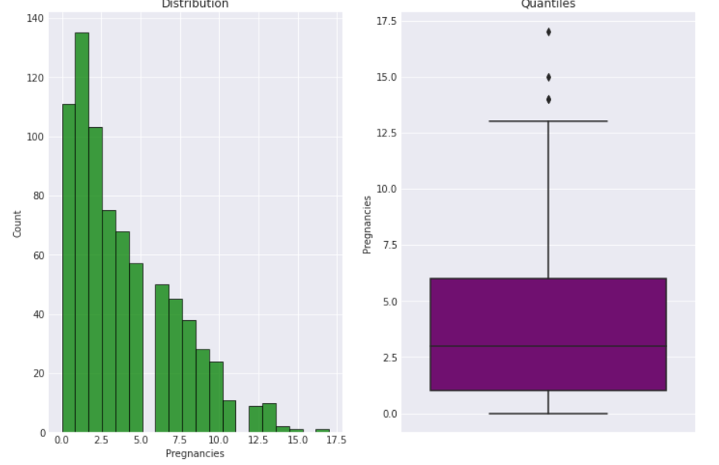
Analysis of numerical values

Slide 8
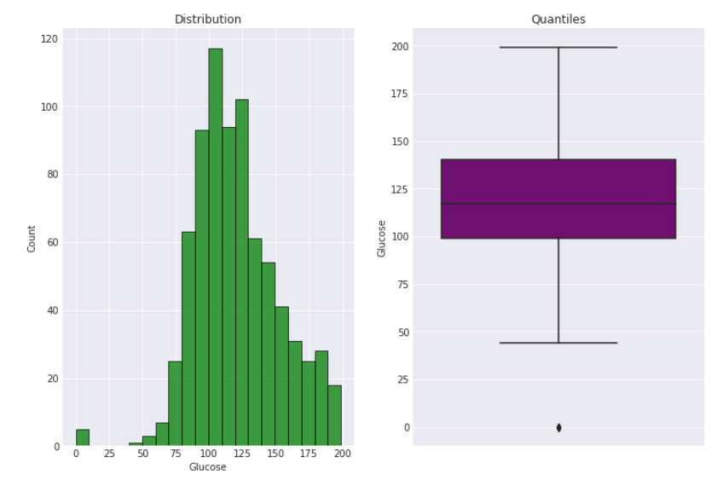
Analysis of numerical values

Slide 9
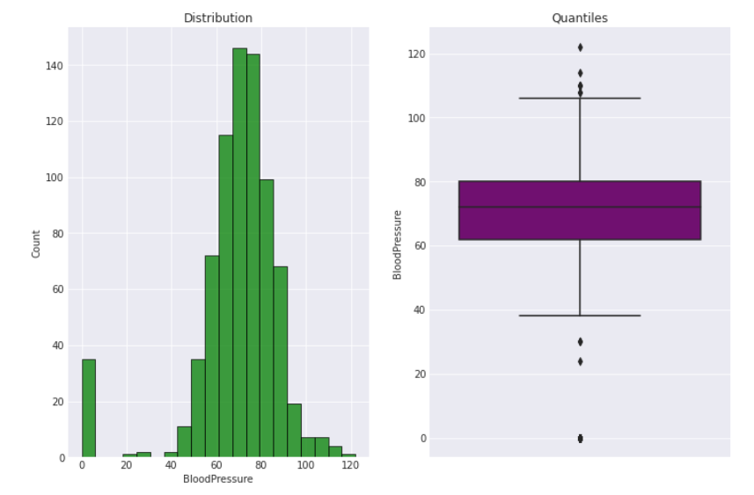
Analysis of numerical values

Slide 10
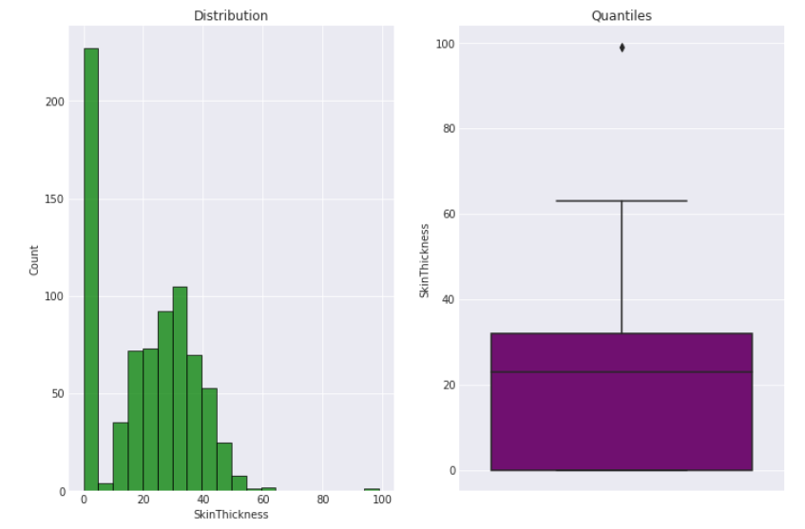
Analysis of numerical values

Slide 11
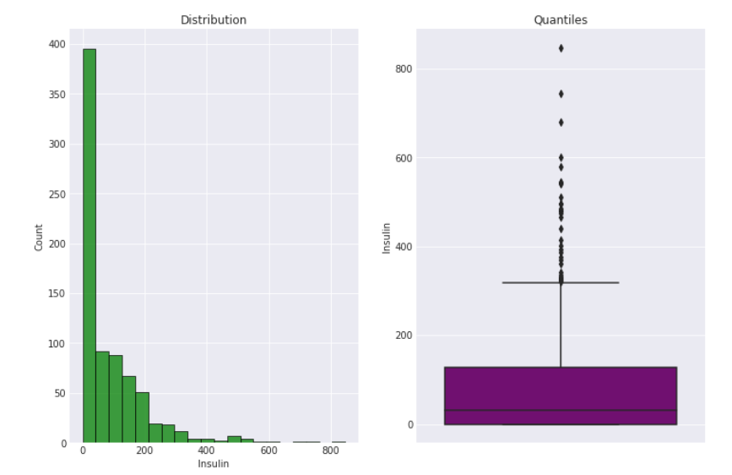
Analysis of numerical values

Slide 12
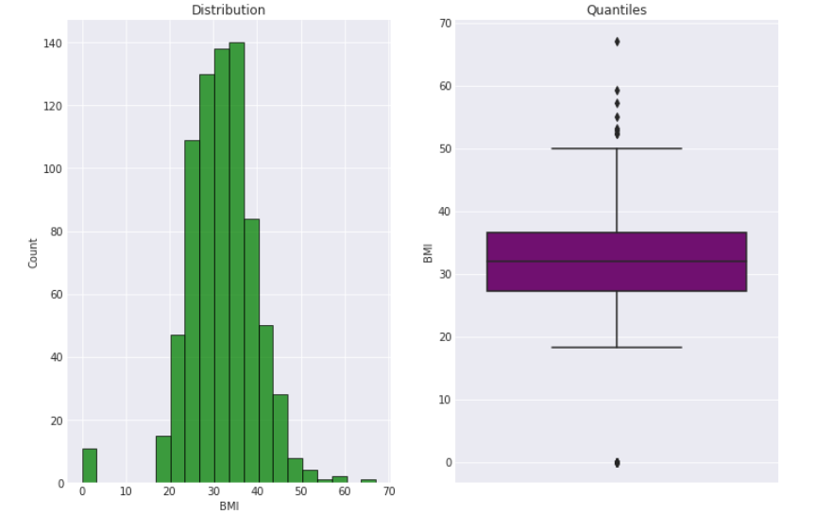
Analysis of numerical values

Slide 13
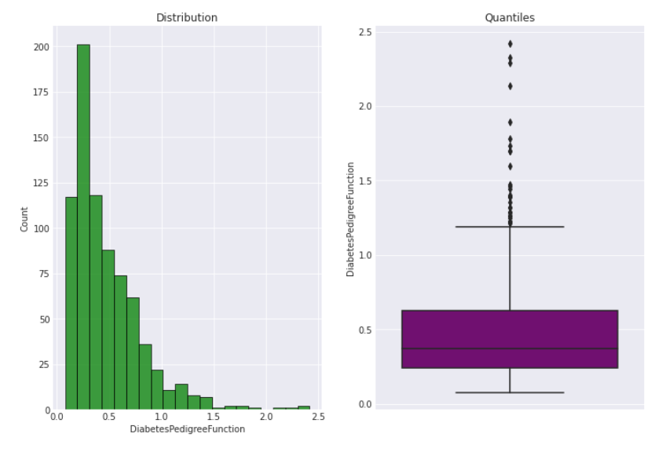
Analysis of numerical values

Slide 14
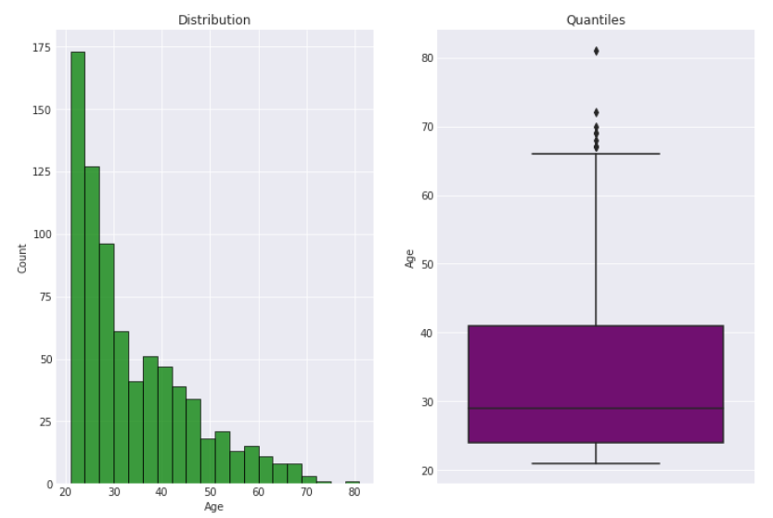
Analysis of numerical values

Slide 15
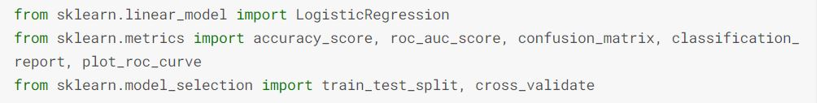
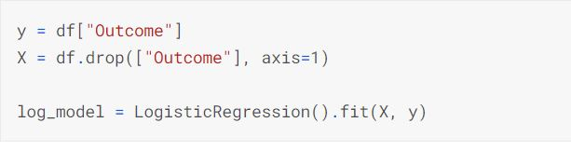
Model
For our project we used Logistic Regression Algorithm for our model to train and fit the data.
Logistic regression is a statistical model that in its basic form uses a logistic function to model a binary dependent variable, although many more complex extensions exist. Logistic regression is a useful analysis method for classification problems, where you are trying to determine if a new sample fits best into a category.

Slide 16
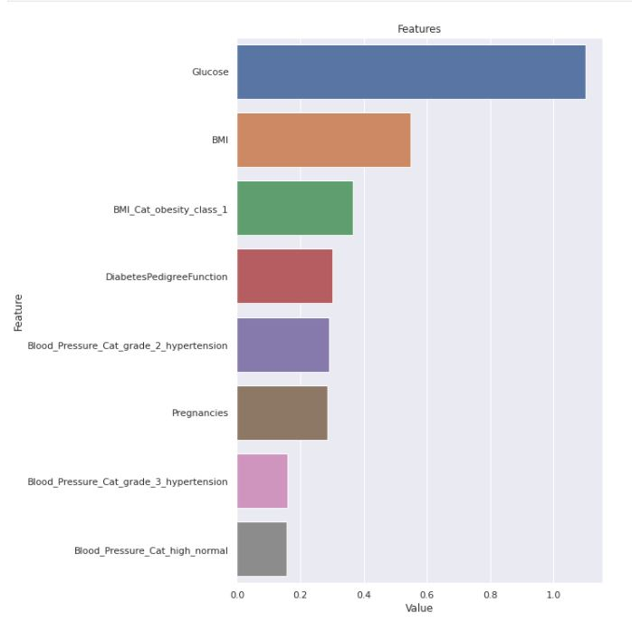
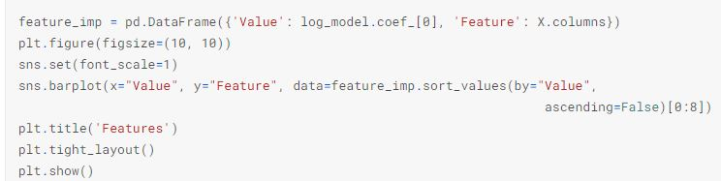
Feature Importance

Slide 17
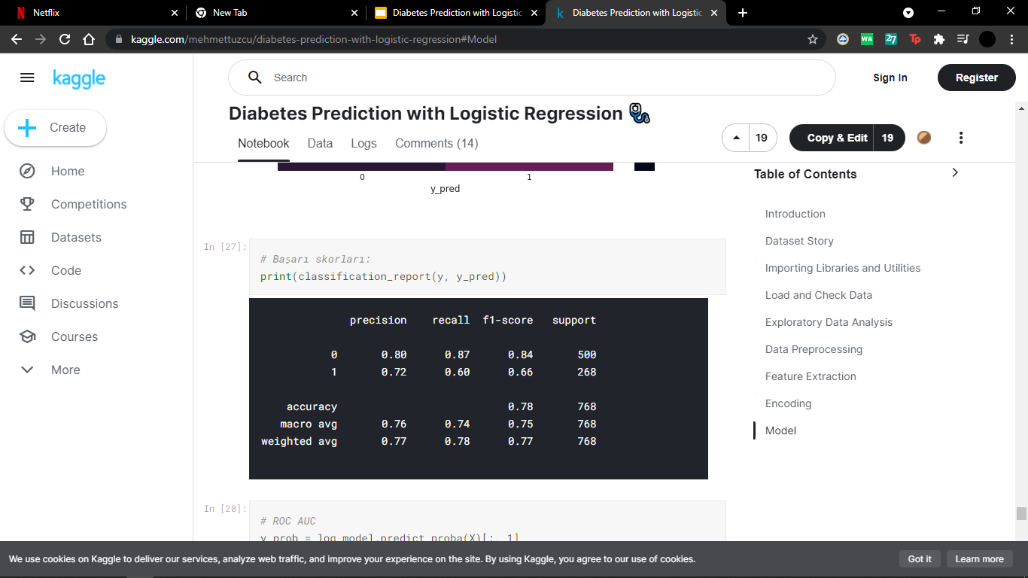
Accuracy
Precision talks about how precise/accurate your model is out of those predicted positive, how many of them are actual positive.
Recall actually calculates how many of the Actual Positives our model capture through labeling it as Positive (True Positive).

Slide 18
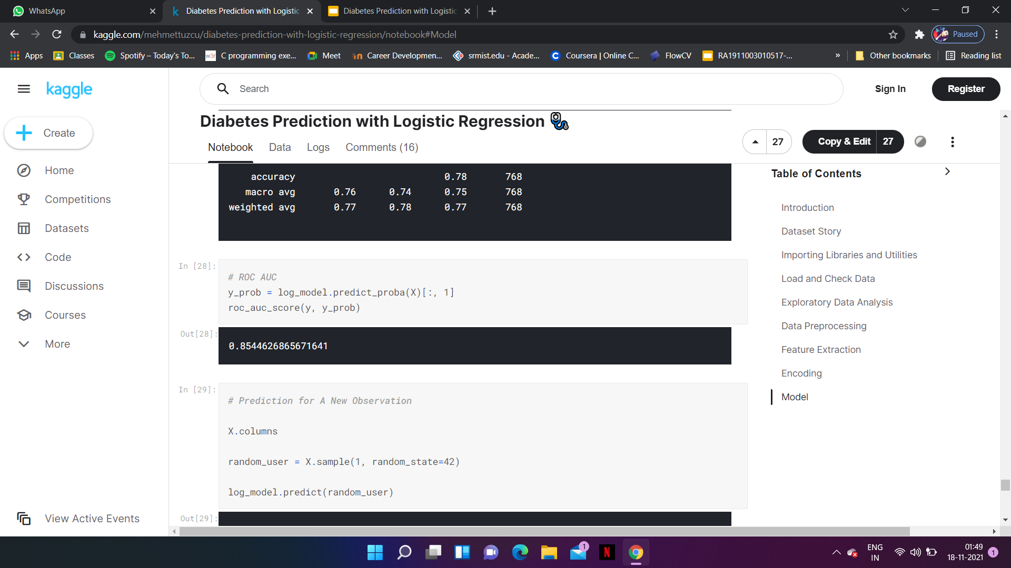
Accuracy
We can determine whether our ROC curve is good or not by looking at AUC (Area Under the Curve) and other parameters which are also called as Confusion Metrics.

Slide 19
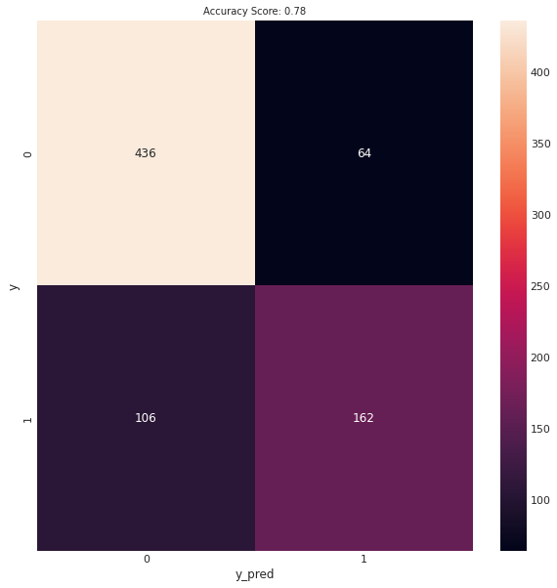
Confusion Matrix
Used to describe the performance of a classification model on a set of test data for which the true values are known.

Slide 20
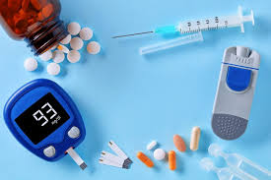
Conclusion
The project involved diabetes prediction with logistic regression with proper data processing using logistic regression. We find out that the main contributors for diabetes are high glucose level,high BMI index and high Blood Pressure. Preferable results were achieved.

Slide 21


